Slide 1
SynthSense
Prototype
Craig Hiller | Frank Lu | Adithya Murali | Krishna Parashar | Tomás Vega

Slide 2
We want to eliminate navigational difficulty for the visually impaired.

Slide 3
Our original plan...

Slide 4
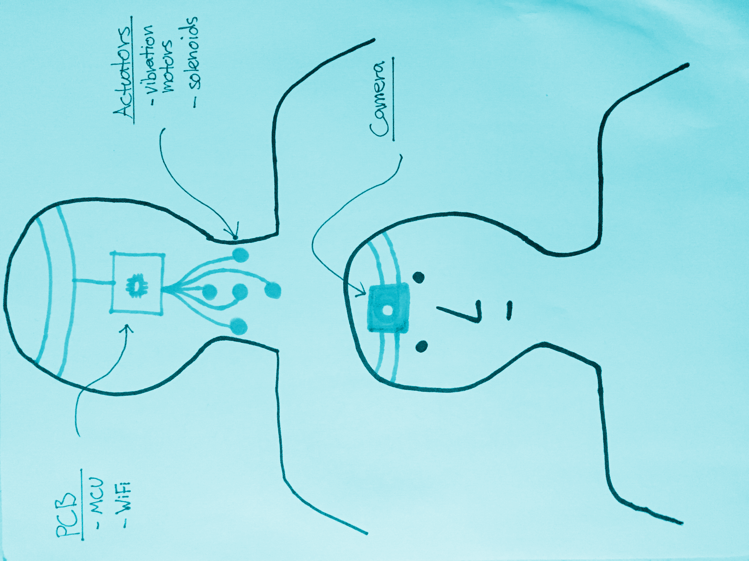
Camera feeds in images.
Computer vision pipeline to extract Visual features from images using a Raspberry Pi.
Features are then translated to haptic feedback.

Slide 5
This won’t work...

Slide 6
Our users don’t want... to wear something bulky and unfashionable.
to get overloaded with sensory feedback.
keep track of yet another device.
to disrupt their auditory sense.
to replace existing systems.
a headache.

Slide 7
Our users want... to enhance their tactile senses.
to wear something sleek and fashionable.
to get useful sensory feedback.
to retrofit existing systems.

Slide 8
A step-by-step navigation assistance device that will get them to their destination without stumbling over sidewalk, getting hit by people or cars, and getting hurt by poles or tree branches - all while retaining familiarity to existing devices.

Slide 9
1 Augmented White Cane
2 Vibrotactile Wristband
3 Navigation App
Notes:
Solution as simple as 1, 2, 3...

Slide 10
1 Augmented White Cane

Slide 11
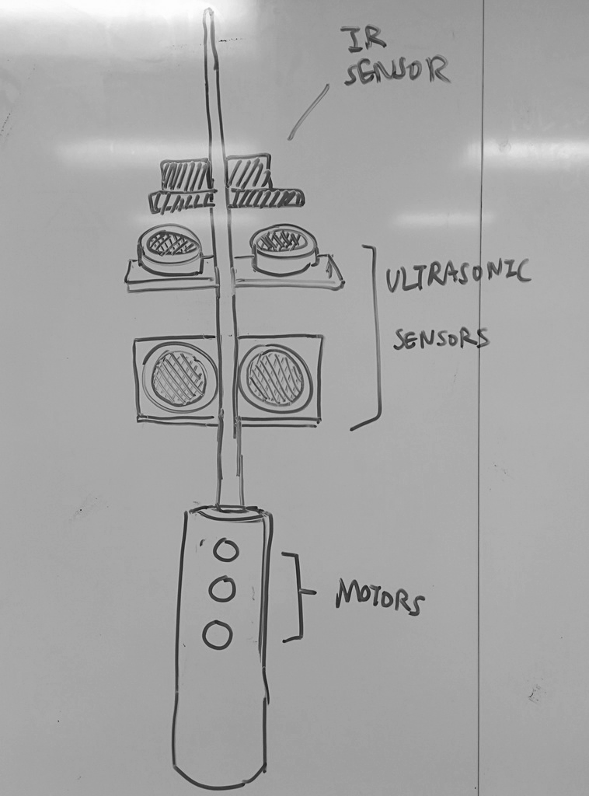
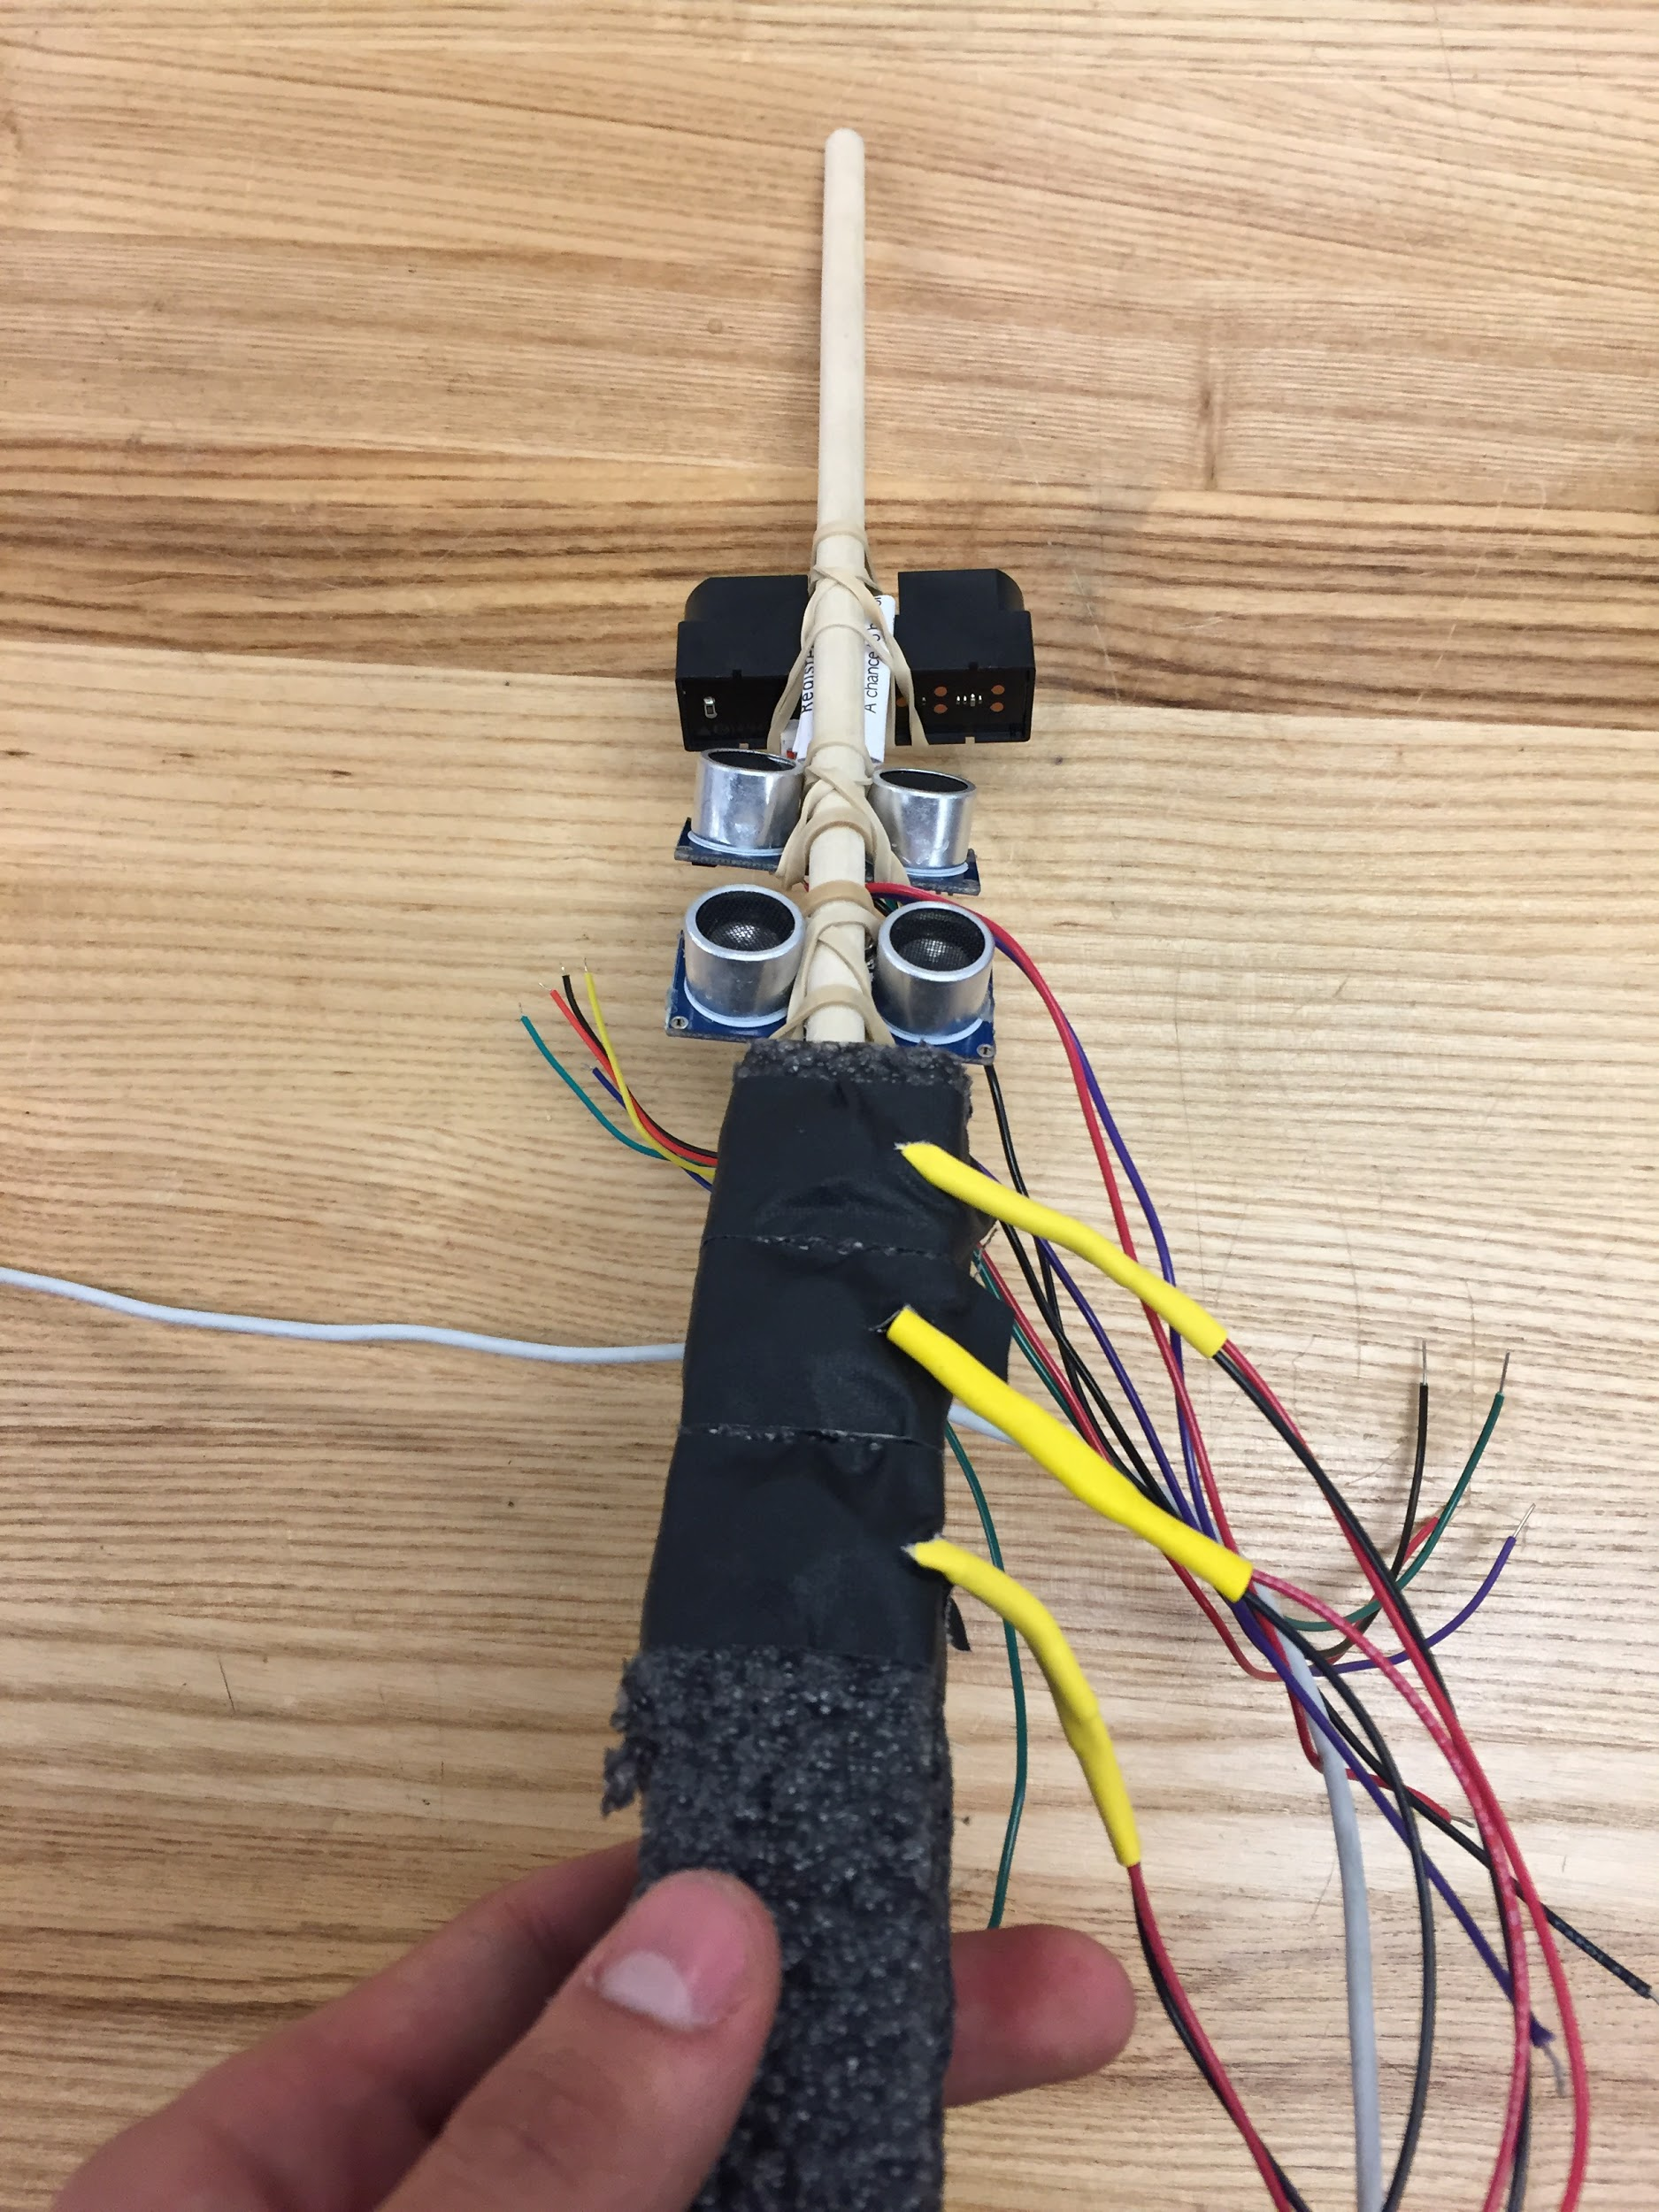
Idea
Prototype

Slide 12
2 Vibrotactile Wristband

Slide 13
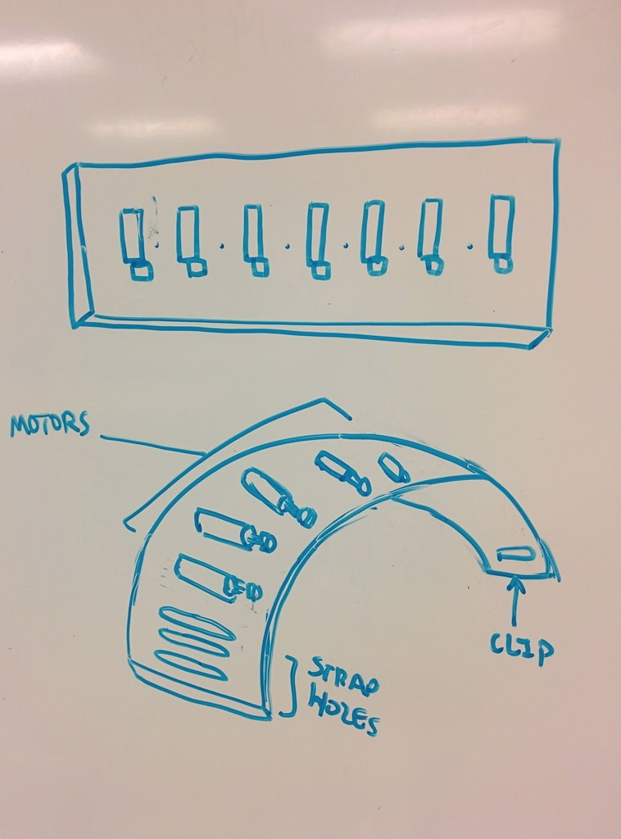
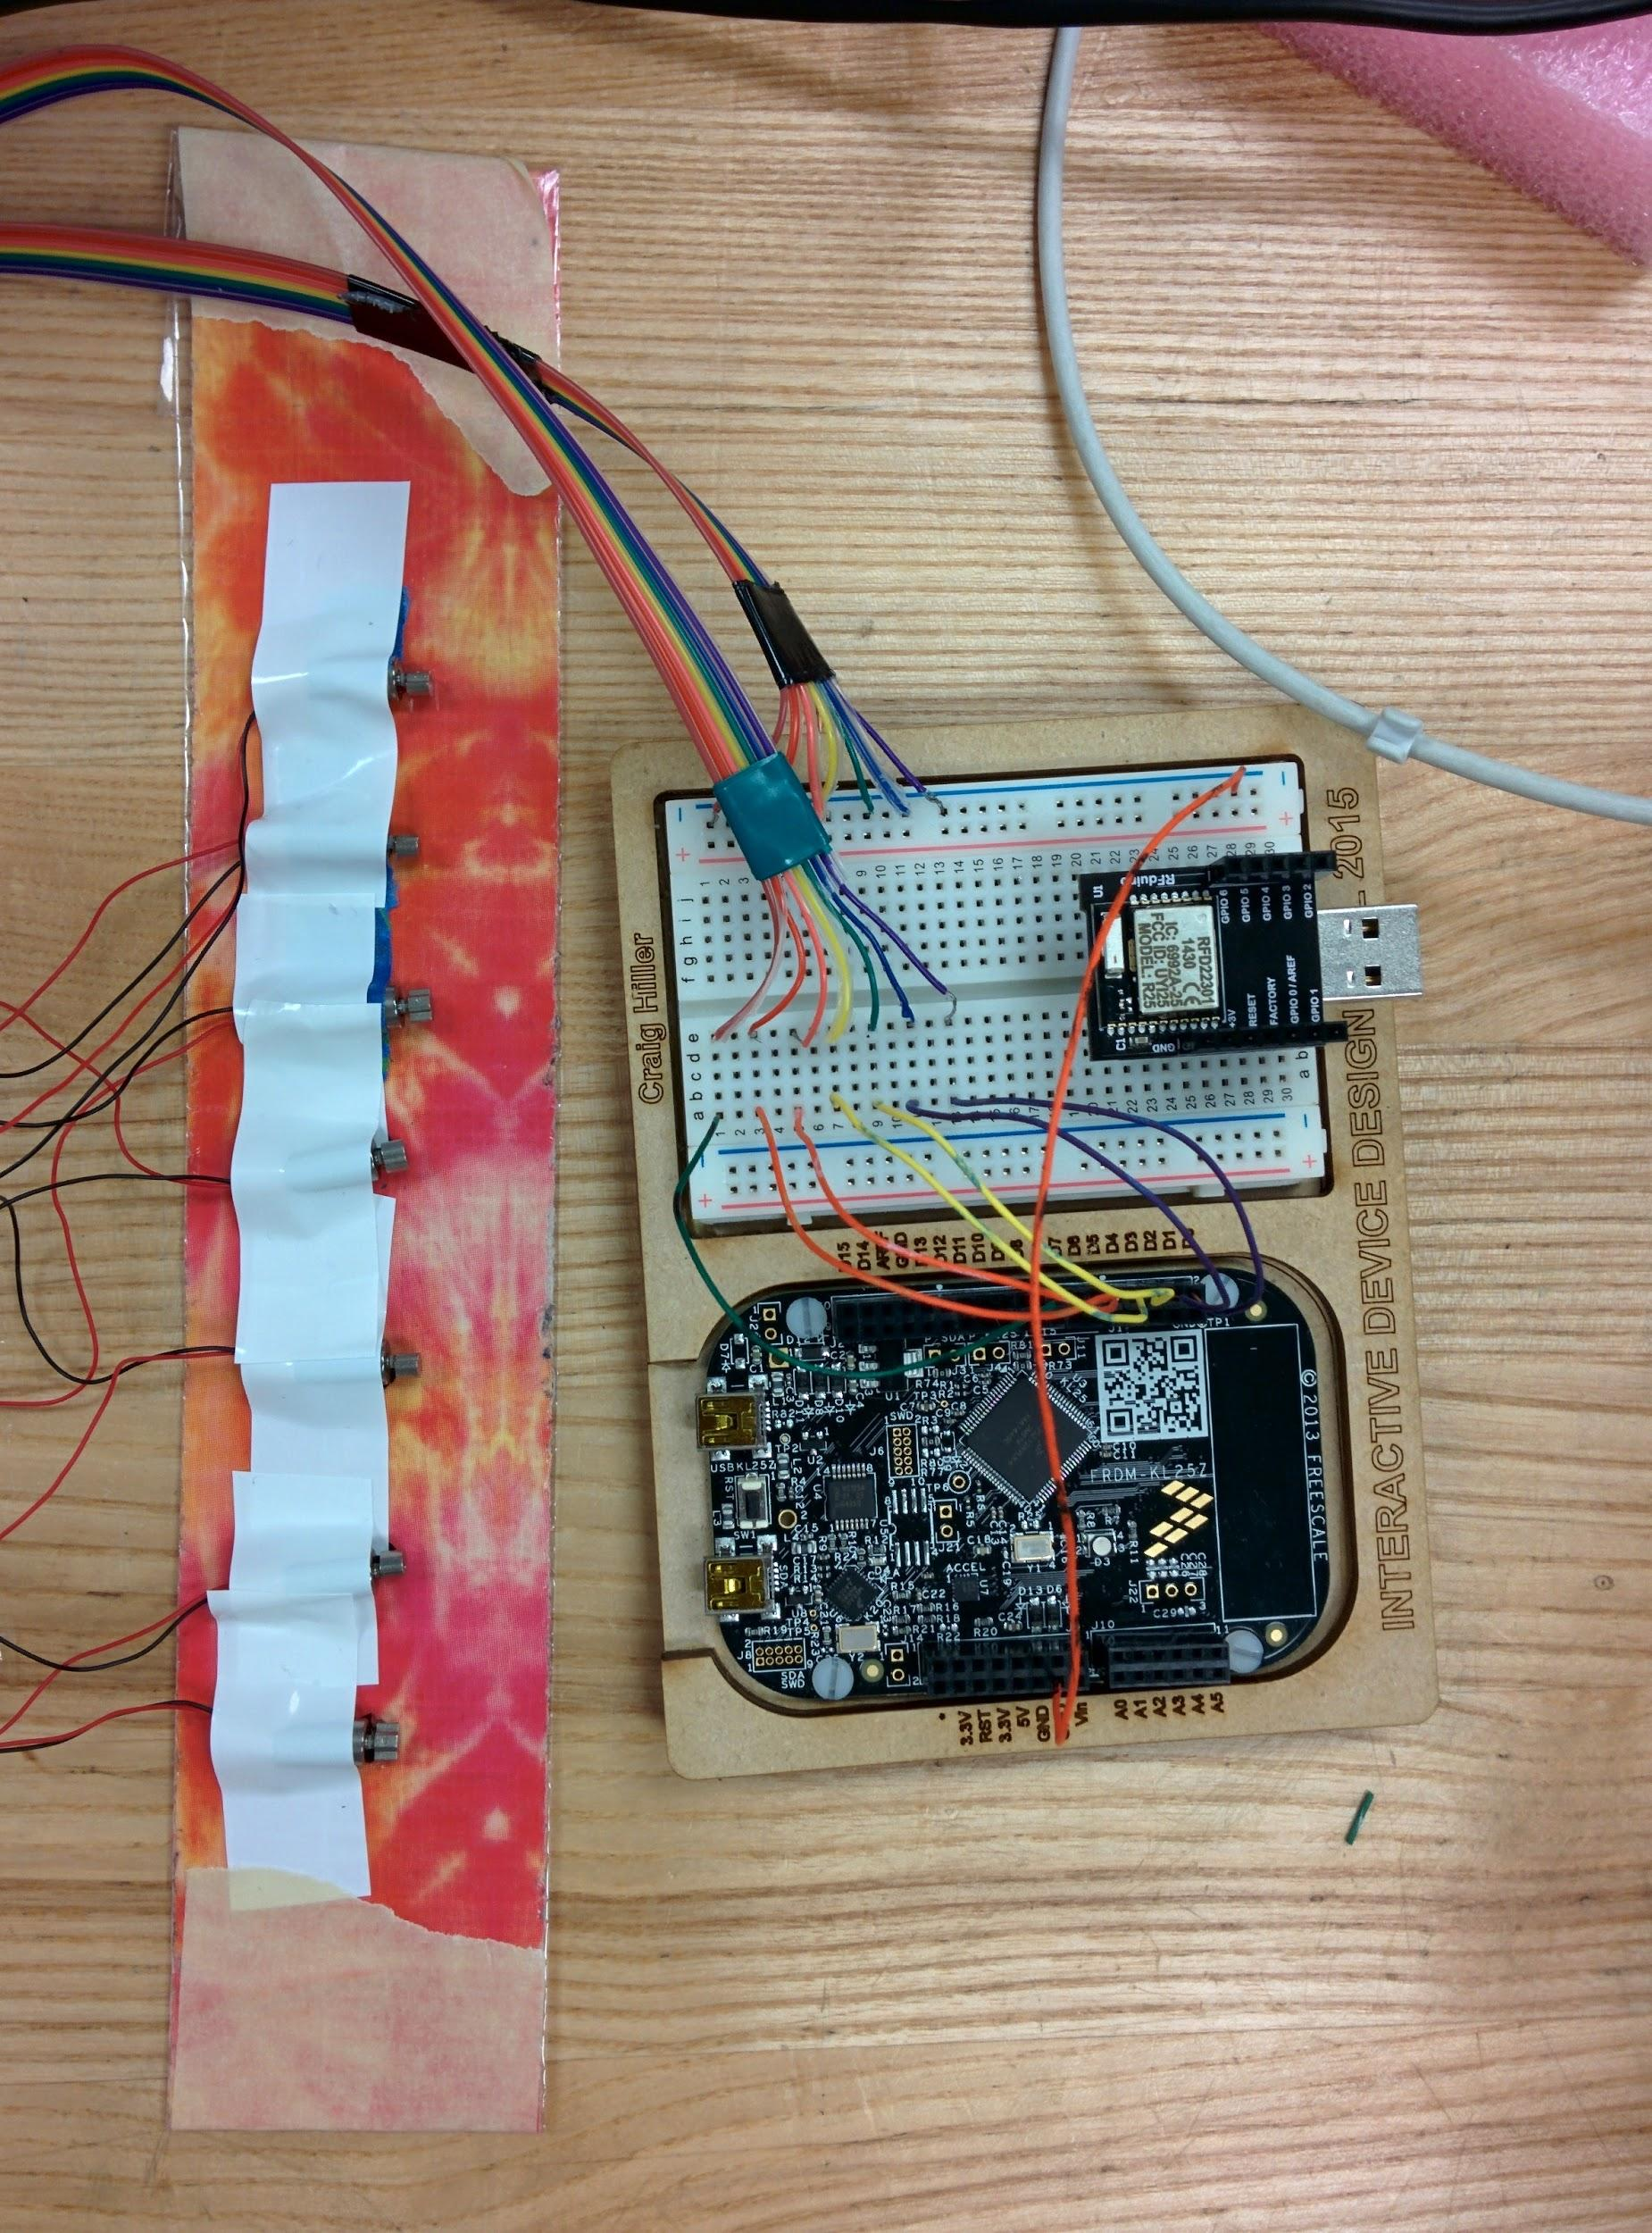
Idea
Prototype

Slide 14
3 Navigation App

Slide 15
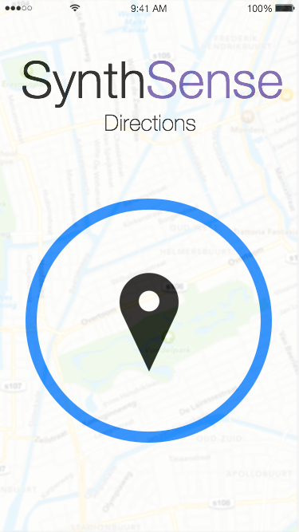
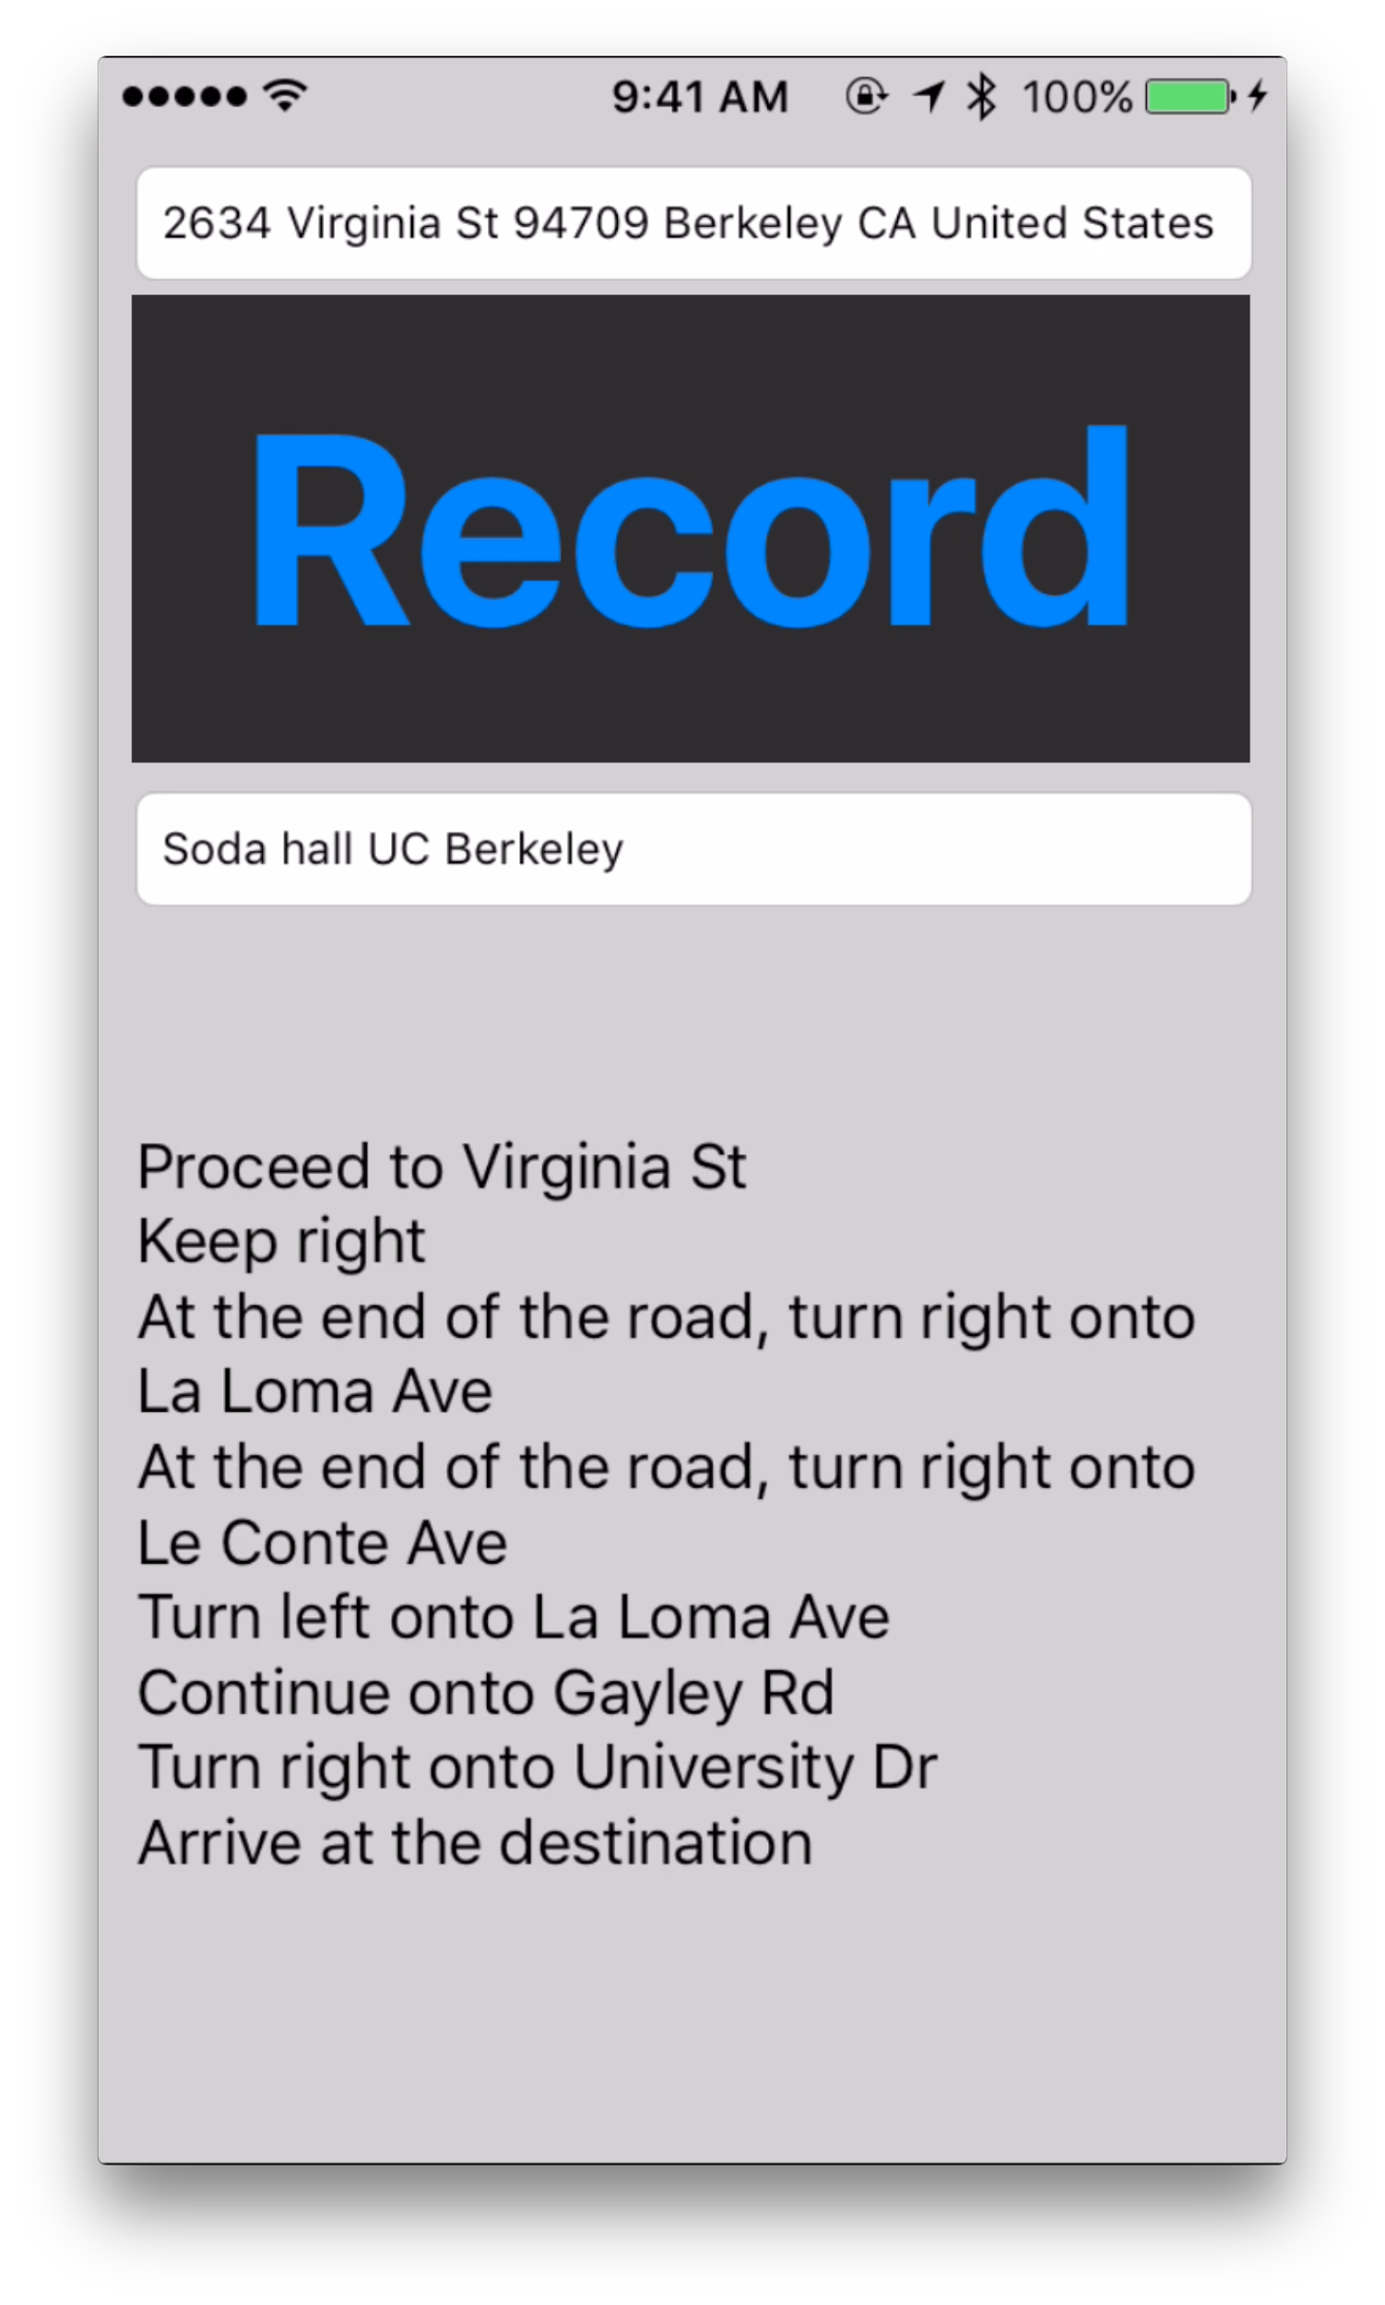
Idea
Prototype

Slide 16
Demo

Slide 17
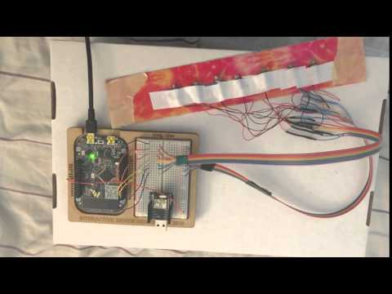

Slide 18
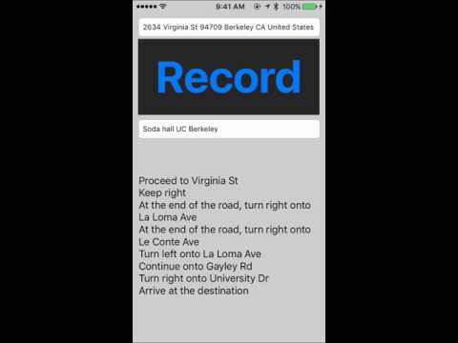

Slide 19
What’s next?

Slide 20
Design and make a wearable band.
Solve the constraints of powering the motors, sensors, and feedback systems.
Connect the three prototypes together.
Demonstrate what we have made to our users.

Slide 21
Questions, Criticisms, Comments?

